Slide 1

ODHE Updates October 2025

Slide 2
Educator Preparation Program Review & State Data
Program standards updates or creation for ~70 program areas and ~20 endorsement areas
PK-8: 48 committee members/19 meetings
Annual data reporting at the institution, state, and federal level on the performance and enrollment of Educator Preparation programs.
Annual MRS Statewide Data collection
Statewide Surveys
Title II Data Reporting
Creation of two data dashboards (more information to come)
Ed prep program approval: efficiency & outcomes
Dormancy and Change Requests
Grow Your Own Teacher Scholarship

Slide 3
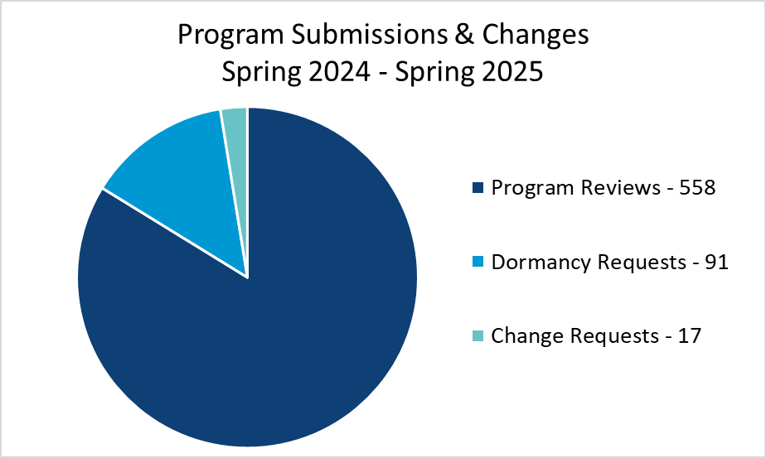
Educator Preparation Program Review & State Data
ODHE is responsible for the review and approval of programs that lead to teacher and administrator licenses in Ohio, and those programs data.
During the 2023 – 2024 academic year there were a total of 5078 students who completed their teacher or principal preparation programs across Ohio.

Slide 4
Fall 2025 Program Review Submissions
The Fall 2025 program review deadline has passed.
ODHE received 4 new programs, 3 institutions submitting their continuing programs, from a total of 7 institutions.

Slide 5
Spring 2026 Program Review Submissions
If you are planning to submit new programs this upcoming Spring, please reach out to the EdPrep@highered.ohio.gov inbox.

Slide 6
Annual Data Reporting
Metrics Reporting System (MRS) is now open for the annual data reporting period.
All data should be submitted by November 31st @ 11:59 PM.
If user updates or program list updates are needed, please contact the MRS-Admin@highered.ohio.gov inbox.

Slide 7
Foundations of Reading
First Time Passage Rates Dashboard
The data reporting period for the 2023 and 2024 report year data has concluded.
ODHE will be requesting the 2025 report year data this fall, through another Qualtrics survey.
This data will be collected through the MRS system in future reporting years.

Slide 8
Upcoming Webinar Science of Reading Modules
This fall ODHE is going to be hosting a webinar regarding the ODEW Reading Modules and how institutions are implementing the modules into courses and programs.
If your faculty or instituion is interested in sharing what they are currently implementing, please reach out to EdPrep@highered.ohio.gov as we are working to finalize the agenda.

Slide 9
Grow Your Own Teacher Scholarship
Scholarships of up to $30,000 for teacher licensure
Commitment to teach in their nominating home district
Open to both high school seniors and current school district employees
Nominees can be from traditional public-school districts, ESCs, nonpublic non-chartered, and community schools

Slide 10

Grow Your Own Awards
 | 2024–2025 Cycle | 2025–2026 Cycle
Nominated | 229 | 856
Completed Applications | 200 | 639
Awarded | 168 | 206
Accepted | 164 | 168
Financial Aid Active | 108 | TBD
Waitlist | N/A | 218

Slide 11
PK-8 Program Standards Update
Program Standards have been approved.
Standards and Crosswalk are available on the ODHE website: https://highered.ohio.gov/educators/academic-programs-policies/academic-program-approval/educator-preparation/ed-prep-institutions#Requirements

Slide 12
PK-8 Program Standards Update
Will be sending a survey this fall to determine what programs institutions have and will want to transition, to either PK-8 programs or to Dual programs.
Currently planning an in-person focused review of programs for early 2027.
Would like to run a smaller review prior to early 2027 as a pilot review. If interested in participating, please reach out.
Would like to hear from all of you if you have ideas or feedback on the process for this review. A survey link will be provided at the end of the slides.

Slide 13
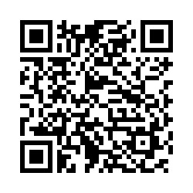
Survey Link for Feeback and Ideas
Upcoming PK-8 Program Reviews
ODEW Math Plan
AI topics
Additional resources or materials ODHE can provide
Upcoming Webinar regarding the ODEW Reading Modules
Any EdPrep related topic
https://ohioregents.co1.qualtrics.com/jfe/form/SV_0iTyjsFxUehKU9o

Slide 14
EdPrep Program Review Redesign Modifications
As announced in August ODHE has identified areas where the EdPrep program review process can become more efficient and focus on program requirements and state priorities.
A full memo is available on the ODHE website here in the August 2025 files:
https://highered.ohio.gov/educators/academic-programs-policies/academic-program-approval/educator-preparation/updates

Slide 15
EdPrep Program Review
Programs will be reviewed in three categories:
Continuing programs
New programs in existing licensure areas
New programs in newly created licensure areas
New programs in existing licensure areas and continuing programs will continue to submit on the current schedule with March 1st and October 1st deadlines.
New programs in newly created licensure areas will be reviewed in an off-cycle review.
This process will be piloted during the PK-8 program reviews that will take place in early 2027.

Slide 16
EdPrep Program Review
Continuing programs will be reviewed on their alignment to state requirements, these sections are captured in the Ohio Common Elements section of the current review process, including:
PBIS & SEL Requirements
Computer Science and Computational Thinking
Ohio Standards for the Teaching Profession and Professional Development
Educators are prepared to use the value-added progress dimensions
Opioid and other substance abuse prevention instruction
Clinical Experience takes place with a practicing teacher trained in the Science of Reading

Slide 17
EdPrep Program Review
Continuing programs will also be reviewed on their Reading Requirements on a 4-Year Cycle, this includes:
Reading/Literacy Requirements
Dyslexia Requirements
Phonics Requirements
More information to come on this cycle as the Science of Reading Audits are completed this fall.

Slide 18
EdPrep Program Review
New programs (both in existing licensure and newly created licensure areas) will undergo the previous program review process, with the following modifications:
Faculty List category; institutions will still provide their qualification policies and the highest degree earned by faculty members.
Assessments; institution created assessments will not be reviewed, only the assessment narrative will be provided.

Slide 19
EdPrep Program Review
The following elements will be removed from the program review process:
To be incorporated into the program listing within JetPack to be updated as needed:
TAG courses for Public institutions
Course Progressions
SPA approval letters
To be reviewed annually at the assessment level:
OAE pass rates, and to provide to panels during review periods

Slide 20
EdPrep Program Review
For the upcoming Fall 2025 submissions ODHE will transition to a 4-day public comment period.
Provide faculty with recognition letters when they have served on a review panel.
Partner with Deans and Chairs for nominations to participate in program review panels.

Slide 21
EdPrep Updates Webpage
A new webpage is available on the ODHE website that will contain shared slides and documents from update meetings like this.
https://highered.ohio.gov/educators/academic-programs-policies/academic-program-approval/educator-preparation/updates

Slide 22
Survey Link for Feeback and Ideas
PK-8 Program Review
Upcoming PK-8 Program Reviews
ODEW Math Plan
AI topics
Additional resources or materials ODHE can provide
Upcoming Webinar regarding the ODEW Reading Modules
Any EdPrep related topic
https://ohioregents.co1.qualtrics.com/jfe/form/SV_0iTyjsFxUehKU9o

